Slide 1
Smart Recycle Bin
Group 7
Chia-Wei Chang
Gavriel Kirichenko
Bikash Giri
Friba Hussainyar
Sergio Medrano
Diparshan Bhattarai
Callum Arul
Hsi-Teng Liu

Slide 2
Agenda & PRESENTATION ORDER
Introduction (with Subspace) - Diparshan
Data Source - Friba
Persona - Sergio
AI Intents - Hsi-Teng Liu
Prioritization - Chia-Wei
To-Be Scenario Map - Beekash
Prototype 1 - Gavriel
Prototype 2 (and Conclusion) - Callum

Slide 3
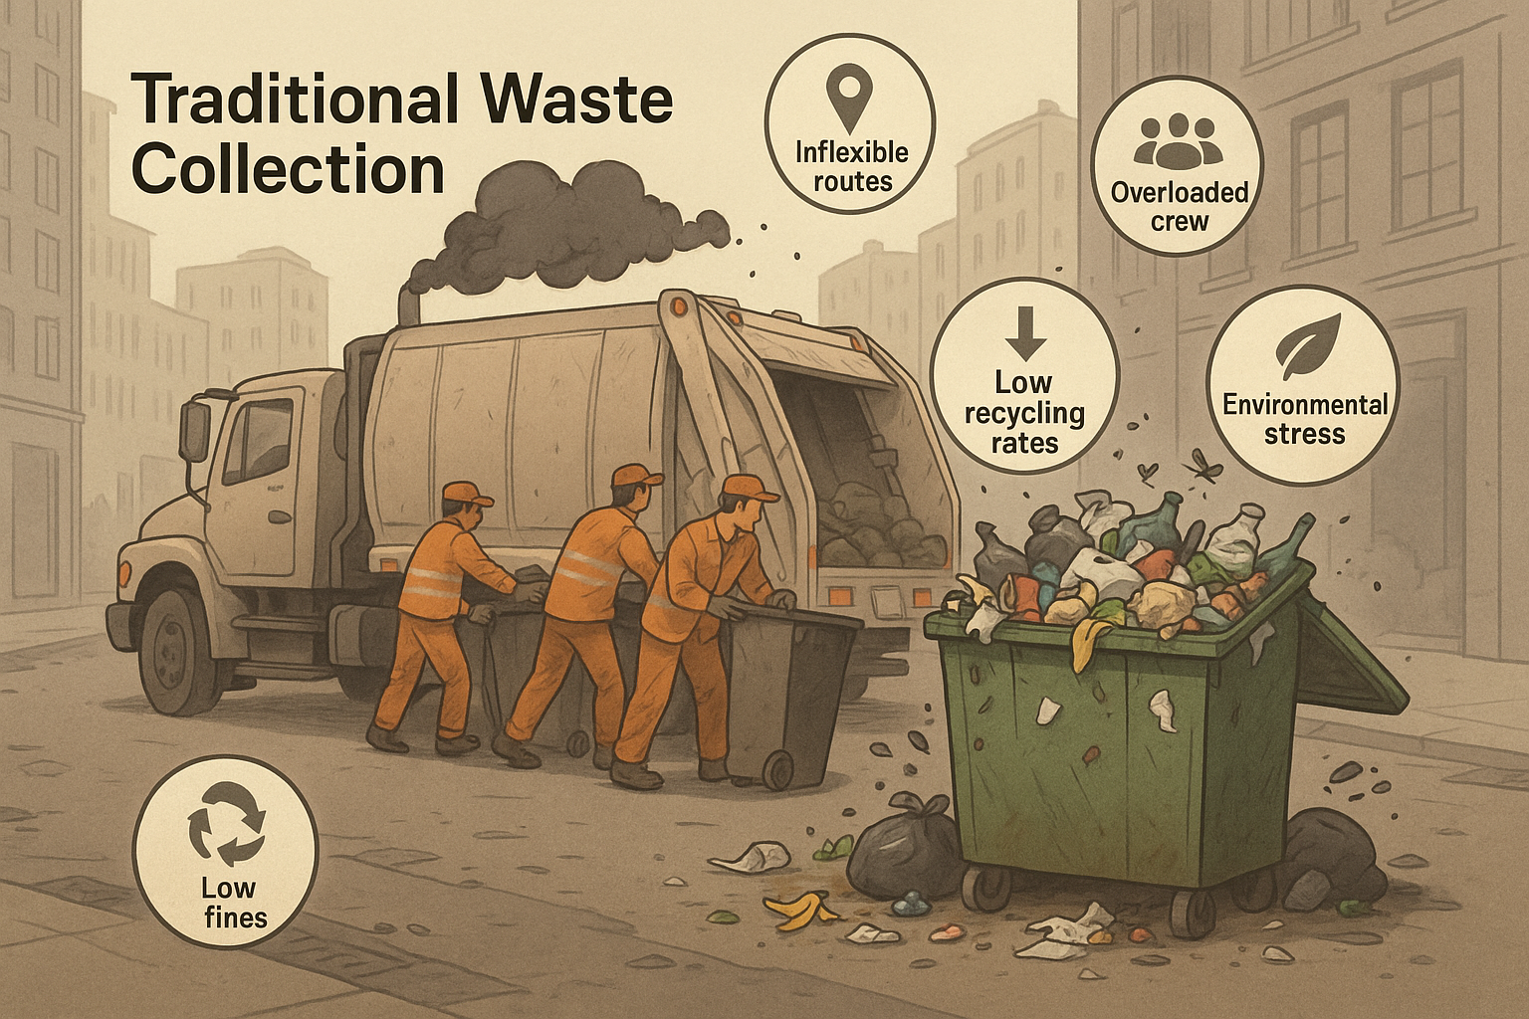
Introduction
Traditional waste collection is inefficient and outdated
Fixed collection routes cause fuel waste, pollution, and overflow
Improper sorting leads to low recycling rates and regulatory fines
Manual tracking is labor-intensive and error-prone
Growing demand for smart, sustainable urban solutions
The Future of Waste Management: Why Change Is Urgent

Slide 4
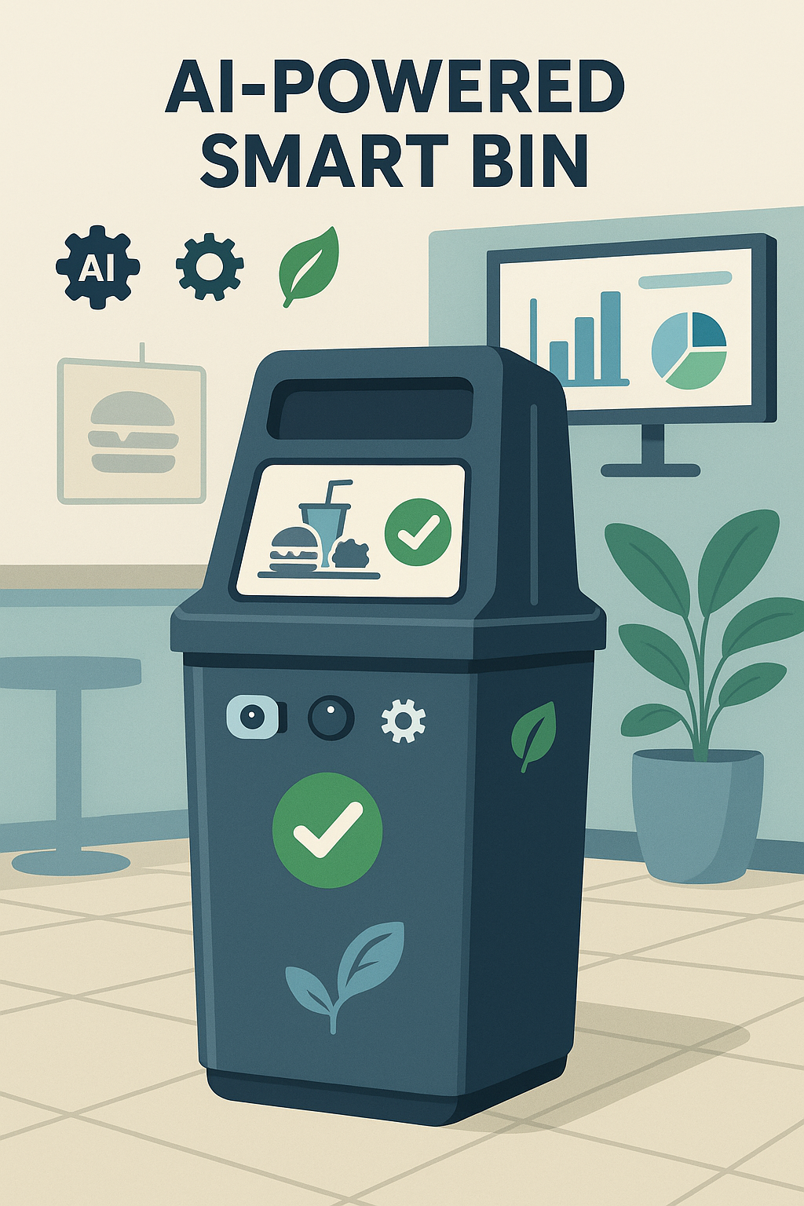
Combines image classification + sensor data for waste recognition
Enables real-time alerts and dynamic route planning
Improves recycling accuracy and reduces contamination
Delivers data-driven reports to support management decisions
Target users: Restaurants, urban waste departments, and smart cities
AI-Powered Smart Bin

Slide 5
Data Source:
Public & have:
Toronto Waste Management Data (Solid Waste Tonnages):
Provides solid waste tonnage data crucial for understanding waste trends in urban areas
OpenAI Environment & Sustainability Datasets:
Offers insights into broader environmental impacts and sustainable practices.

Slide 6
Data Source:
Public & Need:
Real-time waste generation statistics from Toronto Open Data (if available)
Waste generation trends from GODAN (Global Open Data for Agriculture and Nutrition)
Private & Need:
User interaction data with smart bin (how/when it's used)
Data on types of non-recyclable items detected
Waste management in the U.S | Statista

Slide 7
Data Source:
User & Nice to have:
User feedback data
Public & Nice to have:
Global Environmental Impact Data (Pollution & Sustainability Metrics from OpenAI Datasets)
Smart city waste management reports
Private & Nice to have:
Energy consumption of smart bin
Real-time weight measurement of waste per bin

Slide 8
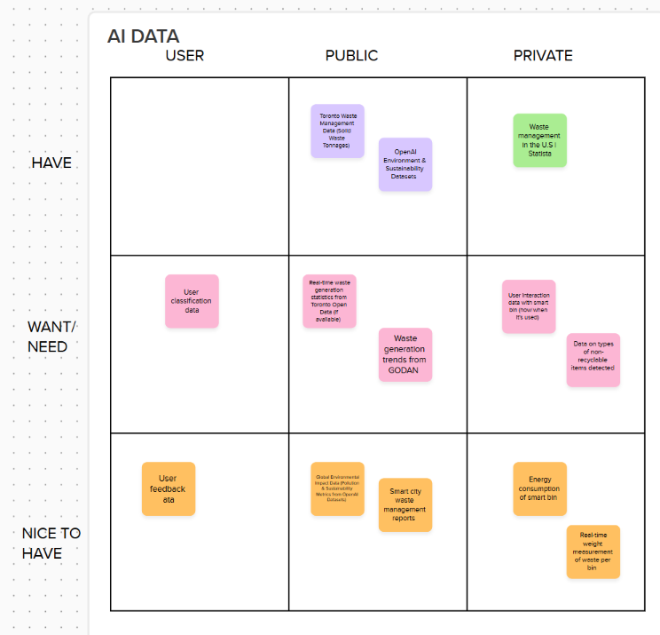
Data Source:

Slide 9
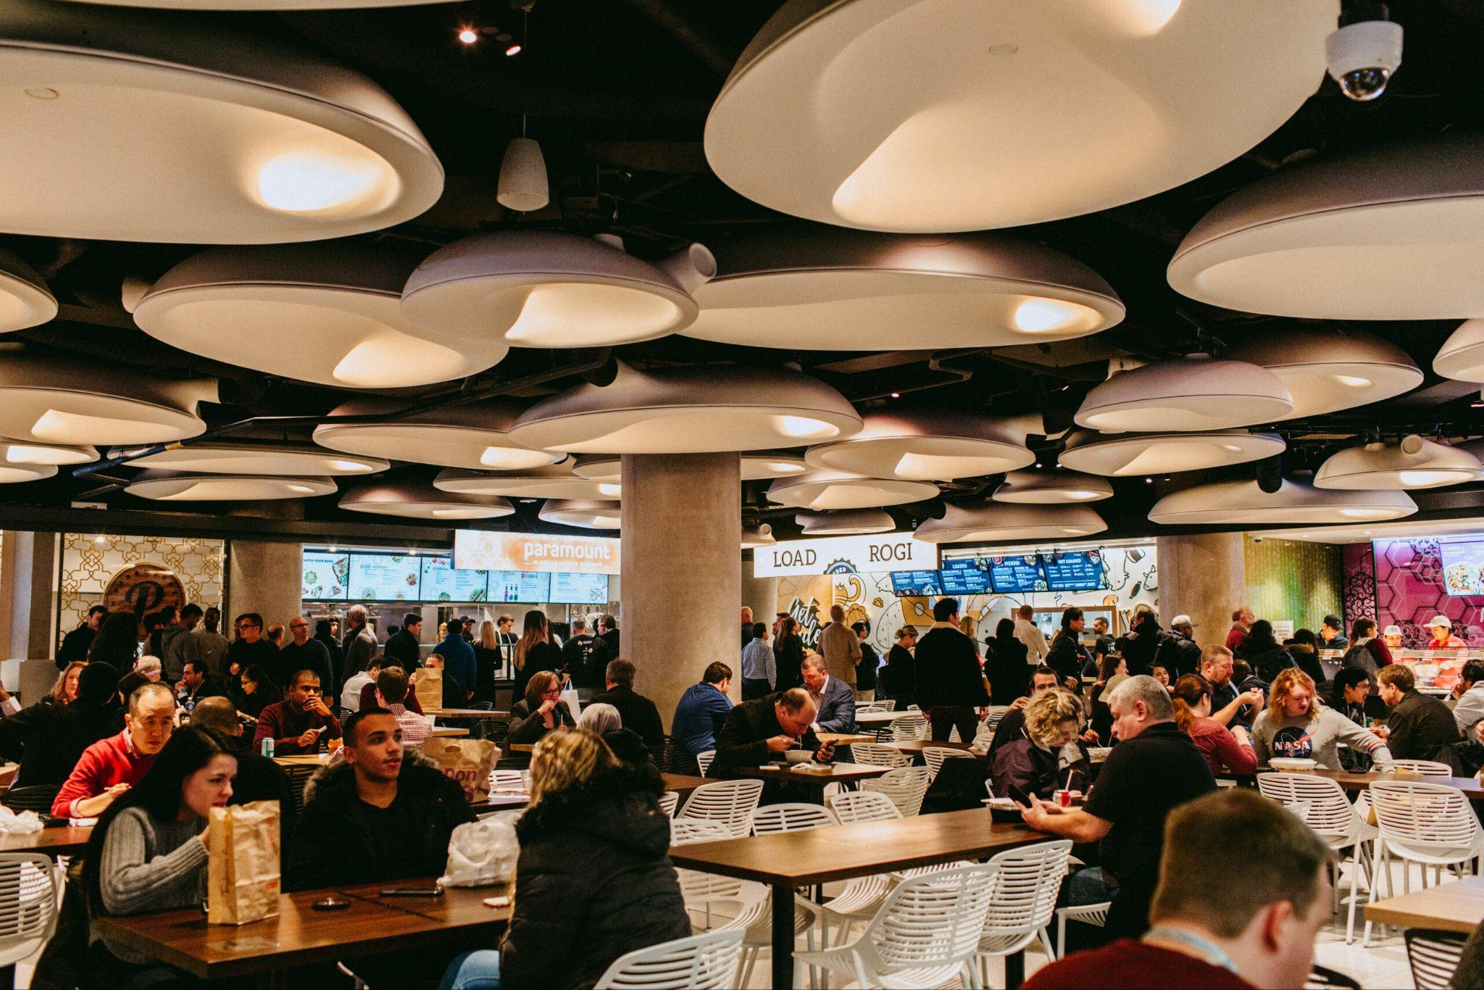
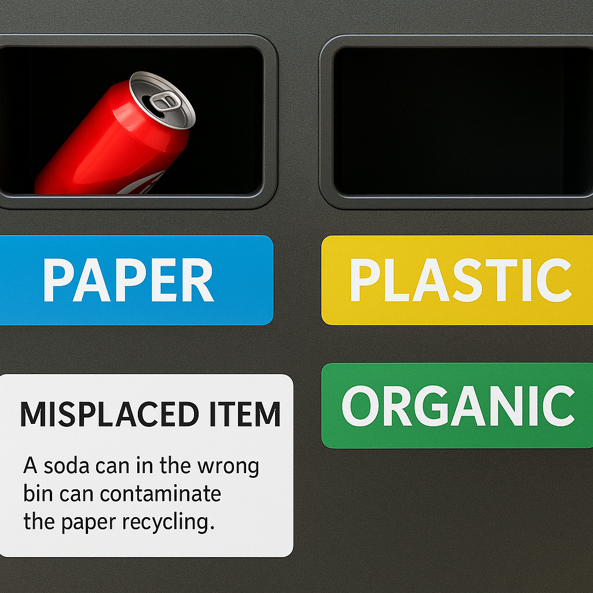
Target Audience

Slide 10
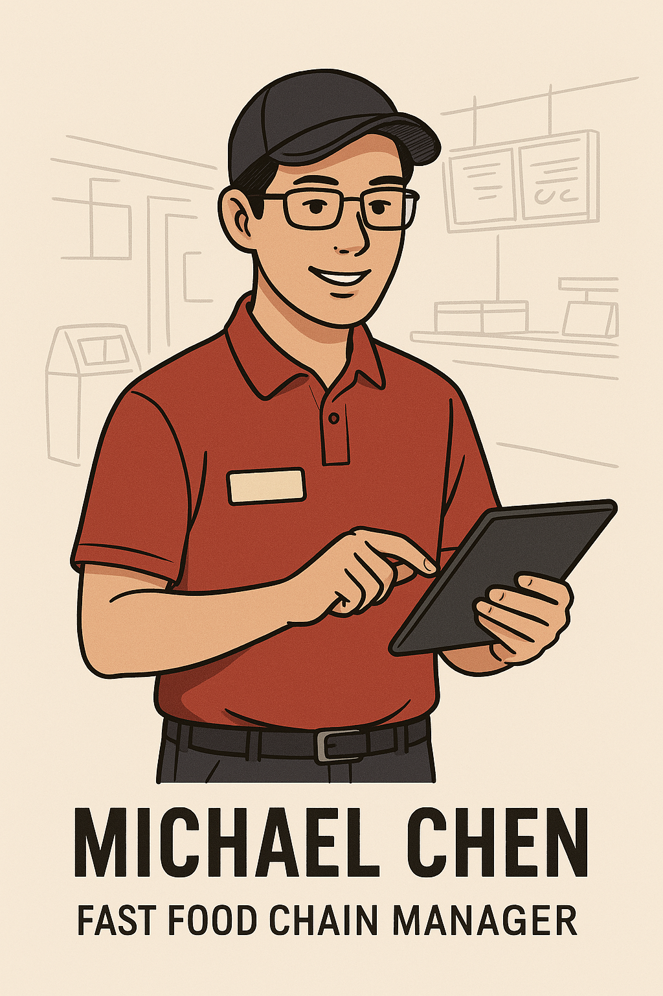
Personas
Michael Chen
Age: 35
Work Experience: Over 10 years in restaurant management
Need and Pain Point
Wants to minimize waste sorting errors to avoid fines or customer complaints
Hopes to have real-time data and reports for operational management and reporting to superiors
Worries about initial costs and maintenance difficulties of new system adoption

Slide 11

AI Intents: Recommend with Confidence
Correct waste classification.
Classifications according to the type of bins which should be categorized to at list 3 principal spots: recyclable, organic, waste.
Direct to waste bin when the classification is of low confidence.
False classifications can be corrected via user feedback on screen for further training.
A primary model for each industry is trained while strategically utilizing models from other industries.

Slide 12
AI Intents: Enrich Your Interactions
Direct people where to drop the trash according to classification result.
Non-disruptive pleasant sound when placed in correct bin
Warnings to management of problems such as malfunctioning and overflowing.
Customer reward programs with participating industries.
Statistics reports to the management and headquarter.

Slide 13
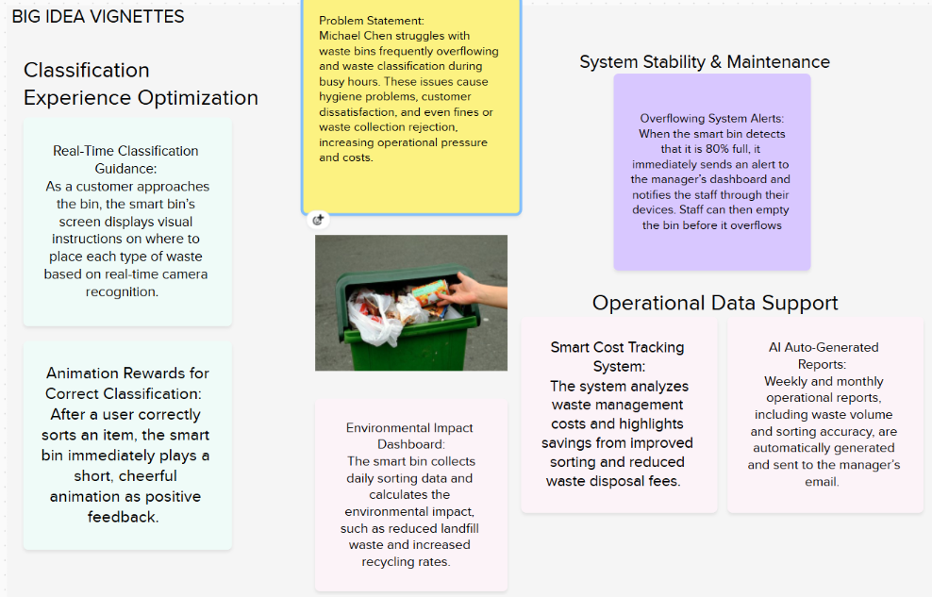
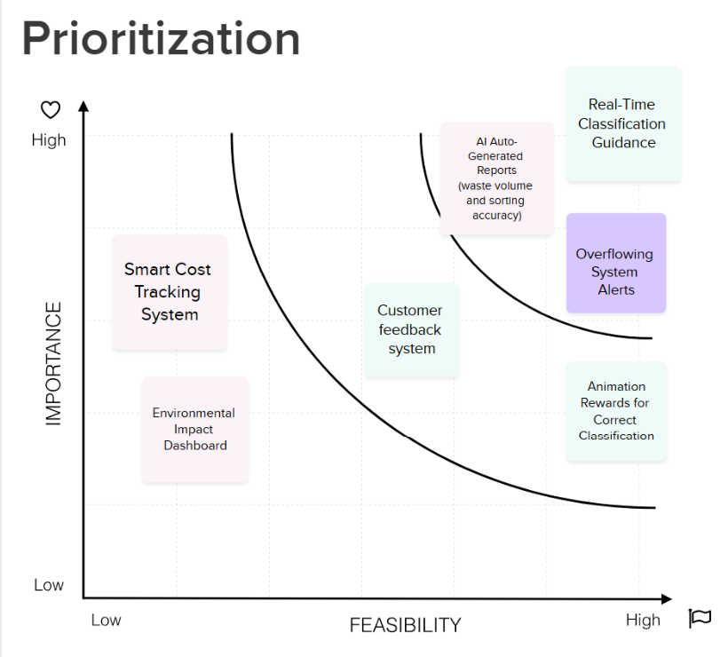
Smart Bin Feature Prioritization
Big Idea Vignettes
Goal
Select features using insights from Big Idea Vignettes
Focus on features with high importance and high feasibility that satisfy the Hills.
Hills
The fast food chain manager can easily check the waste bin status from his phone and see that everything is operational and properly sorted.
When a customer places waste on the platform, the smart bin guides them to separate leftovers and containers into the correct bins.
Notes:
We gathered all the features from the Big Idea Vignettes and insights from the Hills. We then prioritized these features based on their importance and feasibility. Finally, we selected three features that ranked highest in both criteria. These features also align with the Hills and address the stakeholders' expectations.

Slide 14
Smart Bin Feature Prioritization
Prioritized Feature
Real-Time Classification Guidance
Uses real-time camera recognition
Displays on-screen instructions for correct disposal
Aligns with Hill: Guiding users to sort waste accurately
Overflowing System Alerts
Sends alerts when bin is 80% full
Notifies staff through dashboard or mobile
Matches Hill: Managers can monitor bin status remotely
AI Auto-Generated Reports
Real-time/Weekly/monthly reports on waste volume and sort accuracy
Sent directly to manager’s email
Enhances monitoring and operational insights
Notes:
In the top-right corner, these are the three features we selected for our prototype.
Real-Time Classification Guidance: The customer can receive accurate guidance on which type of garbage should be thrown into which bin.
Overflowing System Alerts: The manager gets real-time alerts when a bin is full during busy hours and can clean it right away.
Auto-Generated Reports: Auto-generated reports help the manager check information remotely and in real time

Slide 15
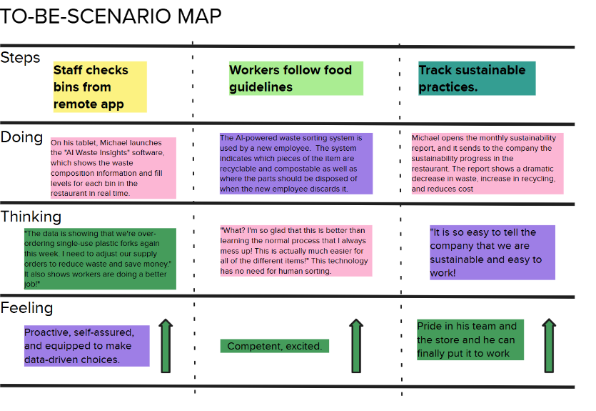
Scenario Map - Overview
Michael and his team at a restaurant use AI-powered tools to manage waste efficiently, improve sustainability, and follow food safety guidelines all while tracking progress remotely.

Slide 16
Scenario Map - Key Takeaways & Benefit
Key Insights:
Remote Monitoring: Staff can monitor waste bins from anywhere.
AI-Driven Sorting: Reduces errors, simplifies training for new employees.
Sustainability Reporting: Tracks progress and reduces operational costs.
Emotional Journey:
Starts with empowerment (staff using data), moves to confidence (easy food disposal process), ends with pride (sustainability achievements shared).
Business Impact:
Better resource management.
Higher recycling and composting rates.
Cost reduction through optimized supply ordering and waste handling.

Slide 17
Prototype Key Tasks
Customer:
1. Placing waste on the counter above the bins to determine which piece of the waste goes to which bin
Manager:
1. Monitor bin status remotely
2. Resolve a smart bin full or error notification

Slide 18
Usability Testing Script
Scenario Customer:
You are just finishing up your meal at the fast-food restaurant, you are about to take the waste and leftovers to the waste bins.
Are you going to segregate the waste?
Do you know how the wastes are segregated?
How long is it going to take just to dispose the waste?

Slide 19
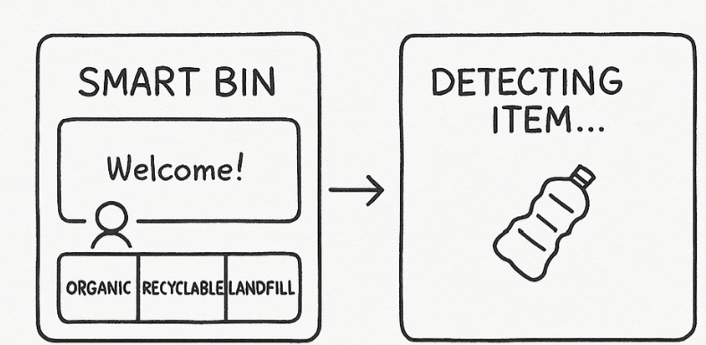
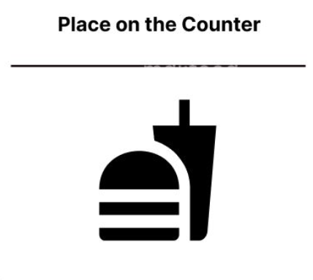
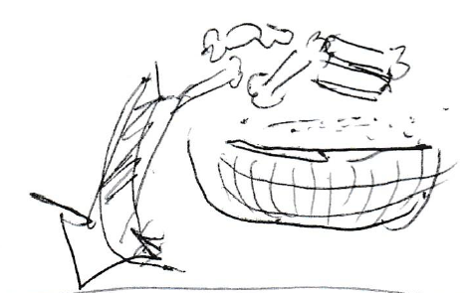
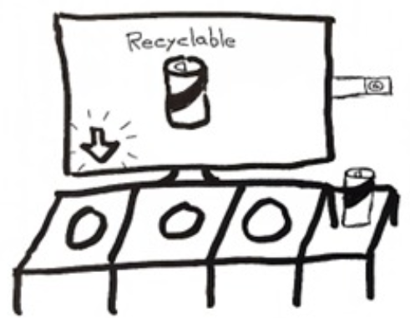
Low-Fidelity Prototype
Scenario Customer: Placing waste on the counter above the bins to determine which piece of the waste goes to which bin
Task 1:
You want to start disposing of waste into the bin. How can you use the prototype to ensure it's properly disposed of?

Slide 20
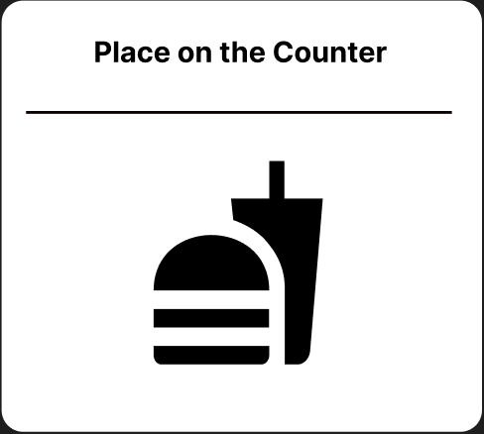

Slide 21
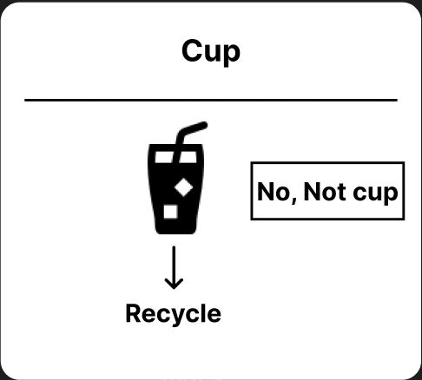

Slide 22


Slide 24
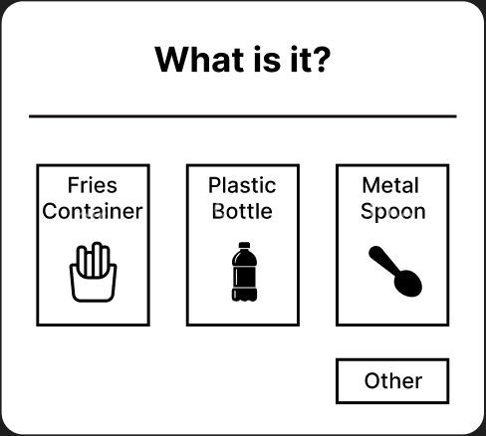

Slide 26
Usability Testing Script
Scenario Manager:
You are a store manager of a fast-food chain. When it comes to cleaning out the waste bins, it is a big hassle. Customers often don't follow the rule of segregating wastes and it hard to know if the bins are full and need cleaning.
During the busy hours, you need to know if the waste bins are overflowing, but you don't have the time to frequently check them.
When cleaning out the waste, a large portion of the wastes are not sorted properly, and the need to be segregated again.

Slide 27
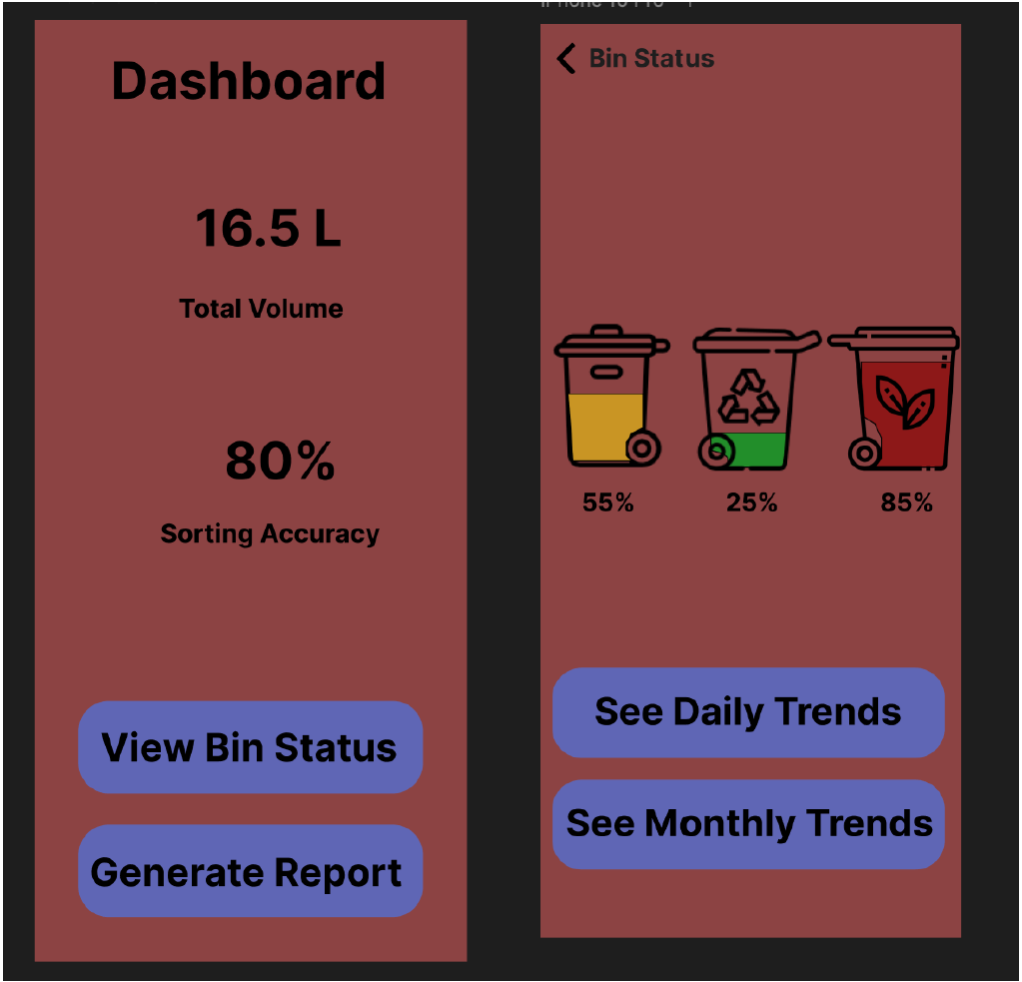
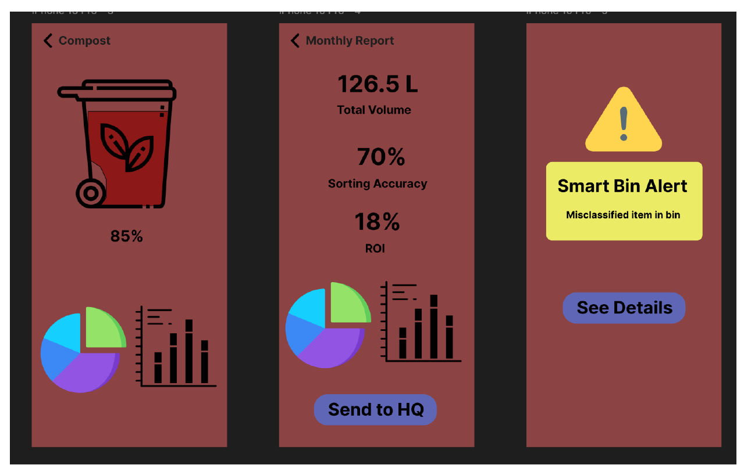
Low-Fidelity Prototype
Scenario Manager: Monitor Bin Status & Resolve a smart bin full or error notification
Screen 1
Screen 2
Task 2:
You want to quickly check which bins in your store are close to overflowing or have
classification issues. How would you do that using the dashboard?”
Screen 3
Screen 4
Task 3:
You want to receive a notification when one of your bins has a sorting issue, and resolve the issue promptly at the right time and location. How can you use this prototype?
Red Bin Sorting Issue

Slide 28
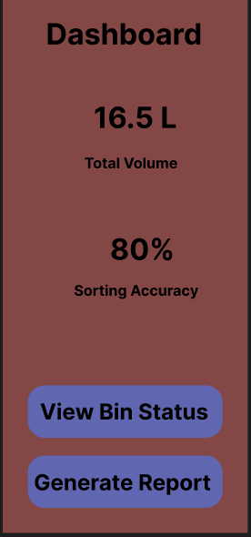

Slide 29
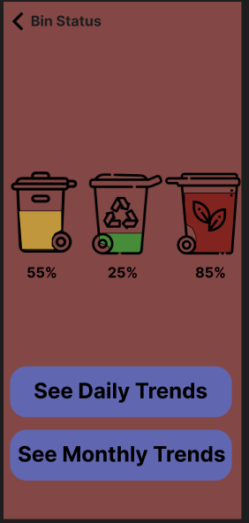

Slide 30
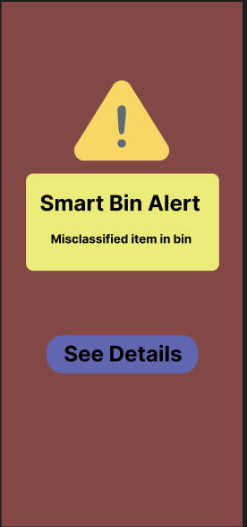

Slide 31

Red Bin Sorting Issue

Slide 32
Conclusion
Reimagining Waste Management with AI
AI-powered bin simplifies waste sorting in restaurants
Enables remote monitoring and real-time insights
Reduces errors and supports sustainability goals
Boosts staff confidence and encourages better habits
Scalable, user-friendly, and impactful solution
Next Steps:
Enhance user feedback mechanisms
Pilot in multiple store locations
Integrate rewards into mobile apps to further drive behavioral change

